Slide 1
Intro to Zero Trust
Paul Horgan @pauliehorgan
Who am I ?
My name is Paul Horgan and I work as an IT Manager for an MSP based in Cork
For those who care about such things, I currently hold CISSP and PMP certifications
Previously I have held Microsoft and Cisco accreditations
Information Security is not my full time job, yet.
I do this as a hobby, which should tell you all you need to know about my personality.
I am active on THM, HTB and Offensive Security’s proving grounds platforms
I like CTF’s and I am on twitter: @pauliehorgan

Slide 2
What is Zero Trust
Intro to Zero Trust
Paul Horgan @pauliehorgan
Where did it come from ?
Developed by Forrester's John Kindervag in 2010
Zero Trust works on 4 main principals :
Verify on a granular level – Every device, user, and network flow must be proven
Least Priviledge – Priviledged Identity/Access Manager
Encrypt everything – Internal and External traffic
Assume Breach mindset – Internal and external threats are always present
Constantly re-evaluate
Log and inspect all traffic
Insert a graphic here

Slide 3
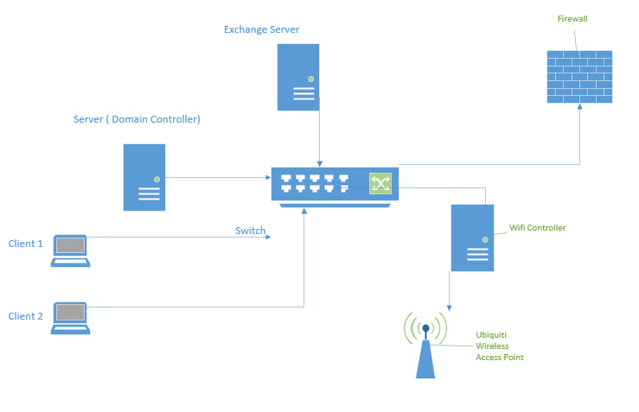
But first - a History lesson
Intro to Zero Trust
Paul Horgan @pauliehorgan
Traditional IT works on a layer of absolute trust.
What does that mean ?
It means that once you have authenticated against a domain controller, you are a trusted entity on the LAN.
Internal access is trusted, external access is not
Think Kerberos.

Slide 4
Why do we want or need Zero Trust ?
Intro to Zero Trust
Paul Horgan @pauliehorgan
So lets walk through a ransomware attack
Get on the network through Phishing or Social Engineering
Install Cobalt Strike/Pegasus or RAT of choice to get persistent network access
Get credentials
Priviledge Escalation
Data Exfiltration
Data Encryption
Blackmail
Profit
Nearly all of Ransomware attacks come from within the network, using a trusted identity.
Zero Trust can play a part in preventing each of these steps from happening.
It is not, however, a magic bullet.

Slide 5

The problem is context
Intro to Zero Trust
Paul Horgan @pauliehorgan
The DC will validate you regardless of how you present yourself
The DC doesn’t know nor care if you are in Europe or Asia or Mars
The DC cant intelligently look at the big picture
All the DC cares is that it asked for credentials and received them
Enter the phishing mail. Once an attacker has your credentials – they have everything
Once they get access to your machine, its all over.
The DC will grant them rights based on your identity
And what if an admin was on your machine last week installing software - mimikatz

Slide 6
Enter Zero Trust
Intro to Zero Trust
Paul Horgan @pauliehorgan
At a very basic level, a Zero Trust system looks at the login in context
Credentials – is it you ?
Endpoint – is it your usual machine and is it in compliance
Geography – do you normally log in from Iran
What are you trying to access
In a nutshell – stop thinking about logins and start thinking about access requests.

Slide 7
Intro to Zero Trust
Paul Horgan @pauliehorgan
Single Accounts
Multifactor
SSO
PAM
Identity
User
Application
Service
Least Privilege
Endpoint
TPM
Encryption
Security Software
Updates
Context
Endpoint protection manager
Managed updates
Conditional access policies

Slide 8
Things Zero Trust can give us
Intro to Zero Trust
Paul Horgan @pauliehorgan
Require multi-factor authentication for users with administrative roles
Require multi-factor authentication for management tasks
Block sign-ins for users attempting to use legacy authentication protocols
Require trusted locations for Azure AD Multi-Factor Authentication registration
Block or grant access from specific locations
Block risky sign-in behaviours
Require organization-managed devices for specific applications

Slide 9
Enter Zero Trust
Intro to Zero Trust
Paul Horgan @pauliehorgan
At a very basic level, a Zero Trust system looks at the login in context
Credentials – is it you
Endpoint – is it your usual machine and is it in compliance
Geography – do you normally log in from Iran
Time – do you normally log in at 3am
What are you trying to access
But its constantly evaluating and re-evaluating that decision
Example 1 :
Paul logs in at 8:30am from his domain joined machine, he accesses his mail and the support ticket system
Example 2:
Paul logs in at 2:30am from a Windows 7 machine. He proceeds to download the finance folder.
Oh, and his IP says he is in Malaysia.

Slide 10
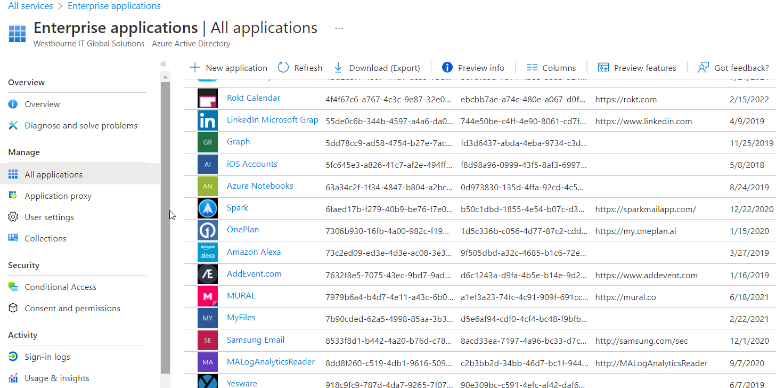
Intro to Zero Trust
Paul Horgan @pauliehorgan
Application control
Azure can control access to a lot of apps.
Like in the previous slides it can block sessions, demand you re-authenticate or send a 2FA request.
You can also publish custom apps
You can make certain apps only available during business hours

Slide 11
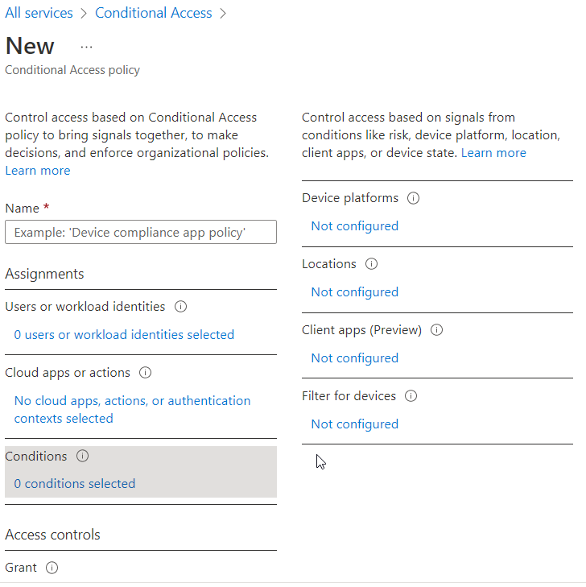
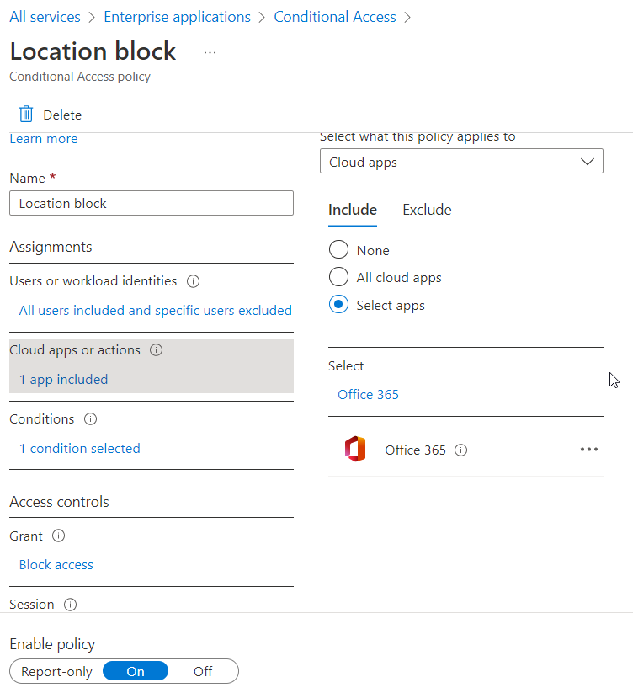
Intro to Zero Trust
Paul Horgan @pauliehorgan
Conditional Access Policies

Slide 12
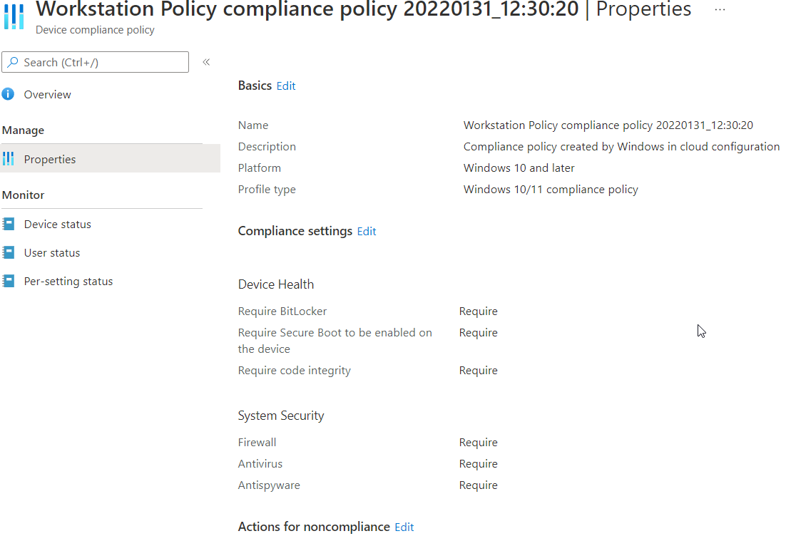
Intro to Zero Trust
Paul Horgan @pauliehorgan
Endpoint compliance

Slide 13
Intro to Zero Trust
Paul Horgan @pauliehorgan
Data Protection
The real aim of all this is to protect data.
Make sure that the people who should have access do, and everyone else doesn’t.
How do you protect data ?
Classify the data – confidential, public, view only, not for print, not for copy or email
Once classified – you can control access
Encrypt the data
Protecting Data / Data Loss prevention is a whole separate talk for another day.
It’s a huge subject.
Zero Trust in and of itself does not give full data protection
There’s shadow copies, replication, backups, tape outs and loads of other fun things before that happens
For this talk its enough to understand that in a Zero Trust system every access to data should be validated and evaluated, from this evaluation a go/no go decision is made.

Slide 14
Intro to Zero Trust
Paul Horgan @pauliehorgan
So what does a Zero Trust network look like ?
Possibly passwordless – move to complete MFA (location + machine + token = access)
MFA on risky objects/applications/logins
Intelligent examination of sign ons – location, time
Workstations with enforced compliance – Bitlocker, code protection, patched
Priviledge Identity Managers – Just Enough Access/Just in Time access
Admin accounts only available to certain people at certain times
Ports and Services only accessible at certain times (RDP anyone?)
Data is protected – no copy, no print, no email, no bulk actions
Everything is logged and passed to the SIEM for analysis (ML)
The network becomes more like a living creature, with wake/sleep cycles and a better ability to distinguish friends from foes

Slide 15
Intro to Zero Trust
Paul Horgan @pauliehorgan
Logs, Logs, Logs
Gathering all this data on attempted logins, data accesses, MFA failures is great- but what do you do with it all ?
This is where your SIEM comes in. Splunk, Azure Sentinel, whatever you’re having yourself.
But a SIEM is much more than just a log repository – a great title for another talk.
Design alerts, decide on sensible responses.
Analyse the data, perform some reporting and machine learning on it, and then feed it back around to help design better and more intelligent conditional access policies, discover which apps need a 2nd layer of MFA applied for example.
Help you to recognise which users need extra protecting.
It can also help you recognise when you have applied too much security – which can lead to shadow IT.
Remember the business will only tolerate Security as long as it doesn’t get in the way of the business functioning

Slide 16
Intro to Zero Trust
Paul Horgan @pauliehorgan
Next Time……..

Slide 17
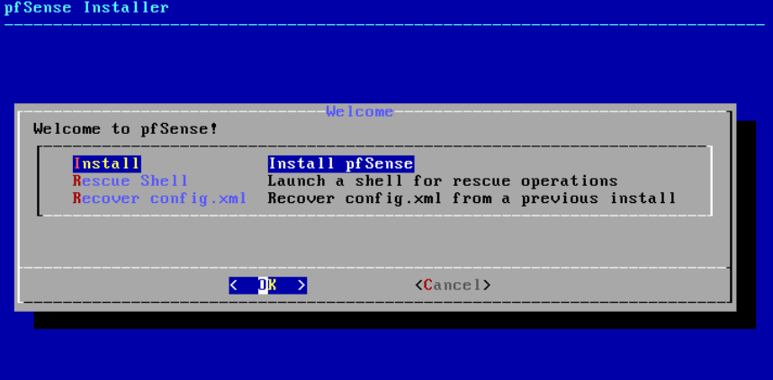
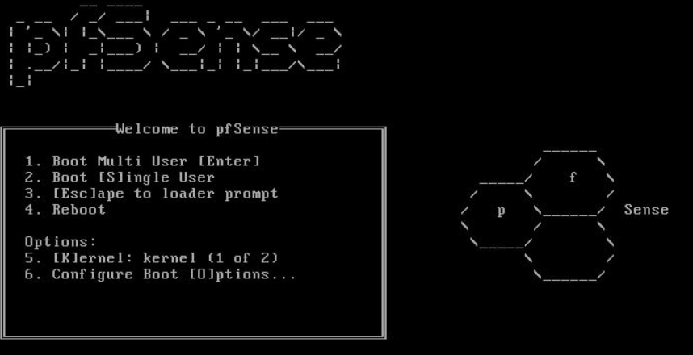
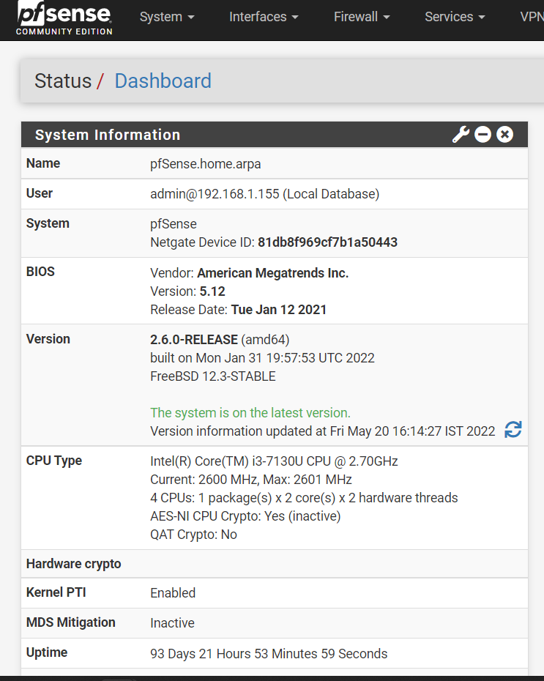
Intro to Zero Trust
Paul Horgan @pauliehorgan

Slide 18
Intro to Zero Trust
Paul Horgan @pauliehorgan

